Slide 1
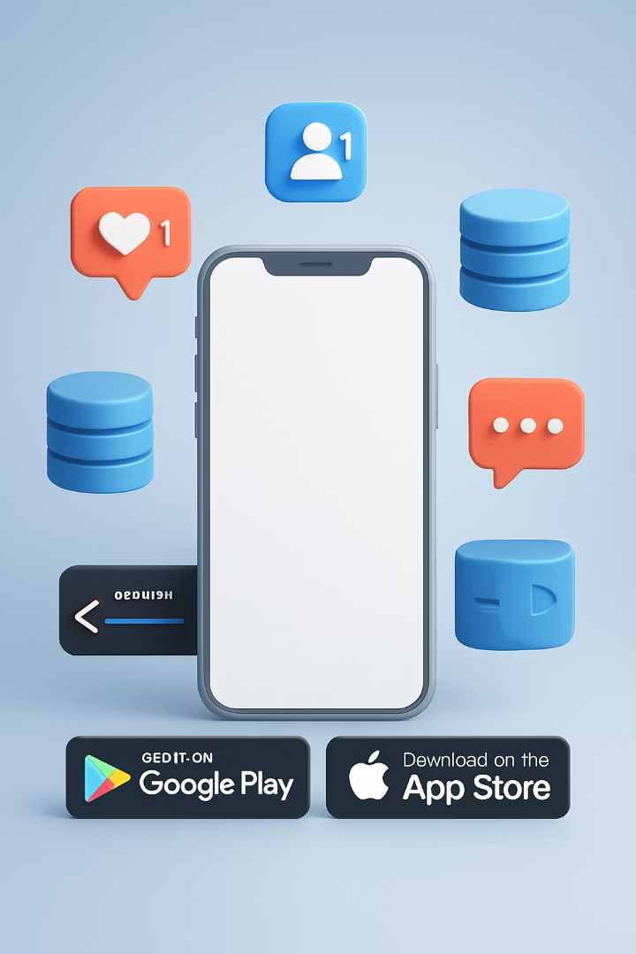
Mobile App Notifications, Databases, & Publishing: A Comprehensive Introduction
Modern mobile applications rely on three key pillars: notifications, databases, and publishing processes.
These components form the backbone of user engagement in today's digital ecosystem.
With 90% of mobile time spent in apps and 3.5 trillion notifications sent annually, mastering these elements is crucial.

Slide 2
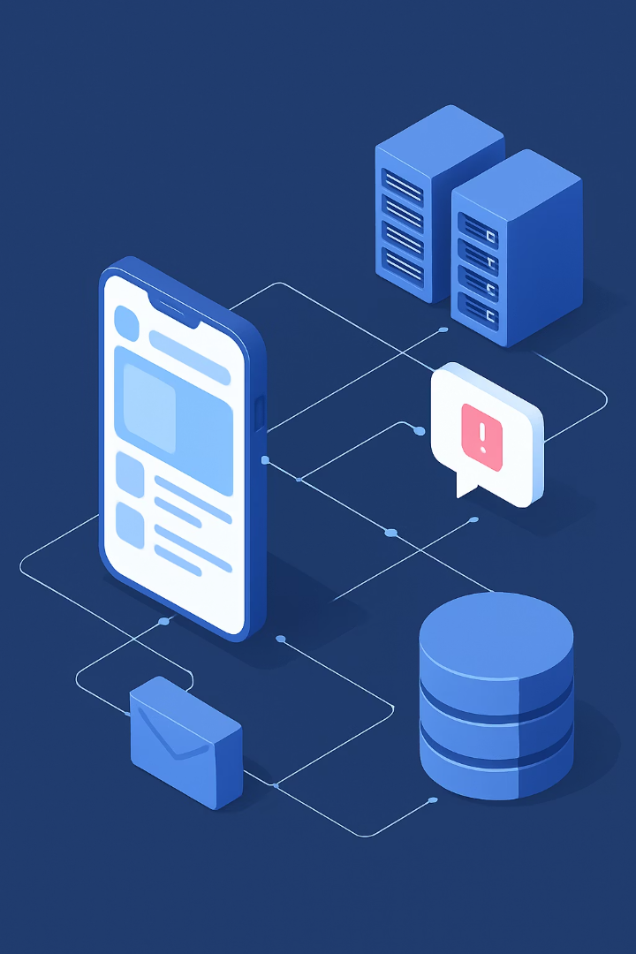

The Mobile App Ecosystem Overview
5.4M
40+
Apps across iOS and Android platforms in 2025
Average number of apps installed per user
18
Apps users interact with monthly
The mobile app infrastructure consists of interconnected components. Frontend interfaces connect to backend systems, databases, and notification services.
This ecosystem enables seamless user experiences across millions of applications.

Slide 3
Understanding Mobile Notifications
Push Notifications
In-App Notifications
Local Notifications
Server-initiated messages. Delivered even when app is closed. Require user permission.
Displayed only when app is running. Don't require system permissions. Higher visibility.
Scheduled by the app itself. Function without internet connection. Useful for reminders.
The technical architecture relies on Firebase Cloud Messaging for Android and Apple Push Notification service for iOS.
Optimized notifications can increase user retention by up to 3x.

Slide 4





Notification Implementation Best Practices
Permission Optimization
Explain value before requesting. Time requests strategically. Target 70% acceptance benchmark.
Rich Media Integration
Include images for 56% higher engagement. Add action buttons. Implement deep links.
Personalization Strategy
Leverage device data. Use location context. Incorporate behavioral patterns.
Technical Requirements
Maintain device tokens. Optimize payload size. Implement secure device registration.

Slide 5
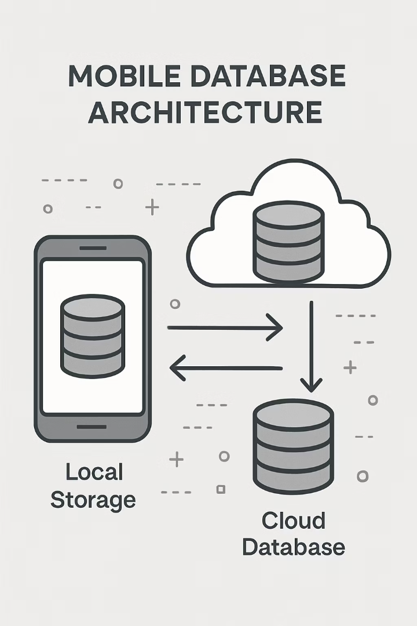
Mobile Database Fundamentals
SQLite
Self-contained
Native on iOS/Android
SQL-based queries
Local storage only
Realm
Object-oriented
Real-time capabilities
Cross-platform
Offline-first design
Firebase Realtime
Cloud-based
JSON structure
Automatic syncing
Scalable architecture
Core Data
Apple ecosystem
Object graph management
Versioning support
Integration with iOS/macOS

Slide 6
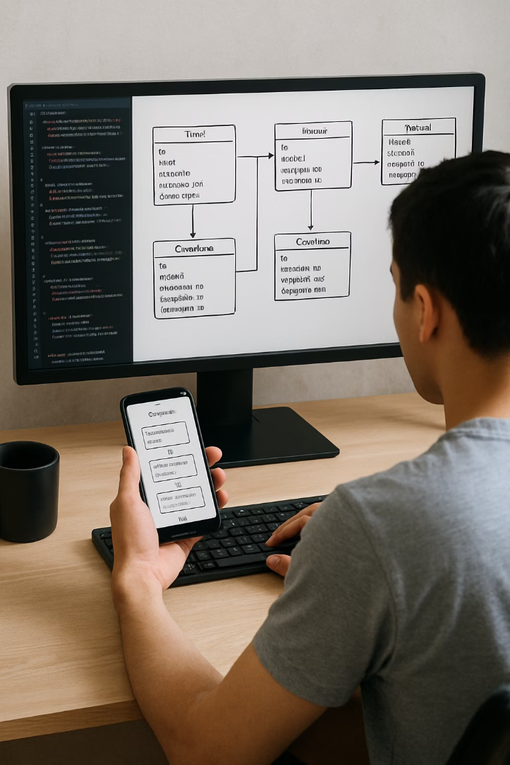




Database Implementation Strategies
Offline-First Architecture
Design for local data access first. Sync with cloud when connection available.
CRUD Operations
Optimize Create, Read, Update, Delete functions. Consider mobile constraints.
Schema Design
Plan data relationships carefully. Balance normalization with performance needs.
Security Implementation
Encrypt sensitive data. Implement proper authentication. Validate all inputs.

Slide 7








Connecting Notifications and Databases
Database Events
Notification Storage
Monitor data changes to trigger relevant notifications
Track history and user preferences in database
Real-Time Data Sync
Analytics Integration
Update UI instantly when notification is received
Capture engagement metrics for optimization

Slide 8
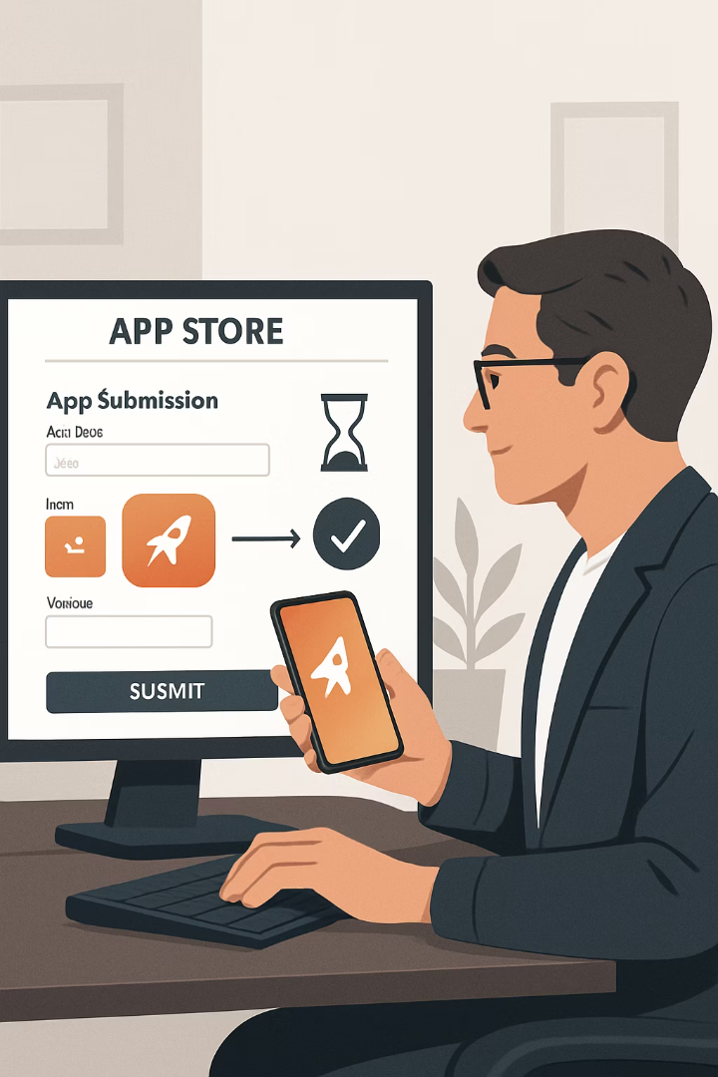
App Publishing Fundamentals
1
Preparation
Generate certificates and provisioning profiles. Compile release build. Test thoroughly.
2
Submission
Complete store listings. Upload binary. Provide screenshots and metadata.
3
Review
Wait for store approval. Address any rejection issues. Typically 24-48 hours.
4
Release
Schedule public availability. Monitor initial performance. Respond to feedback.

Slide 9
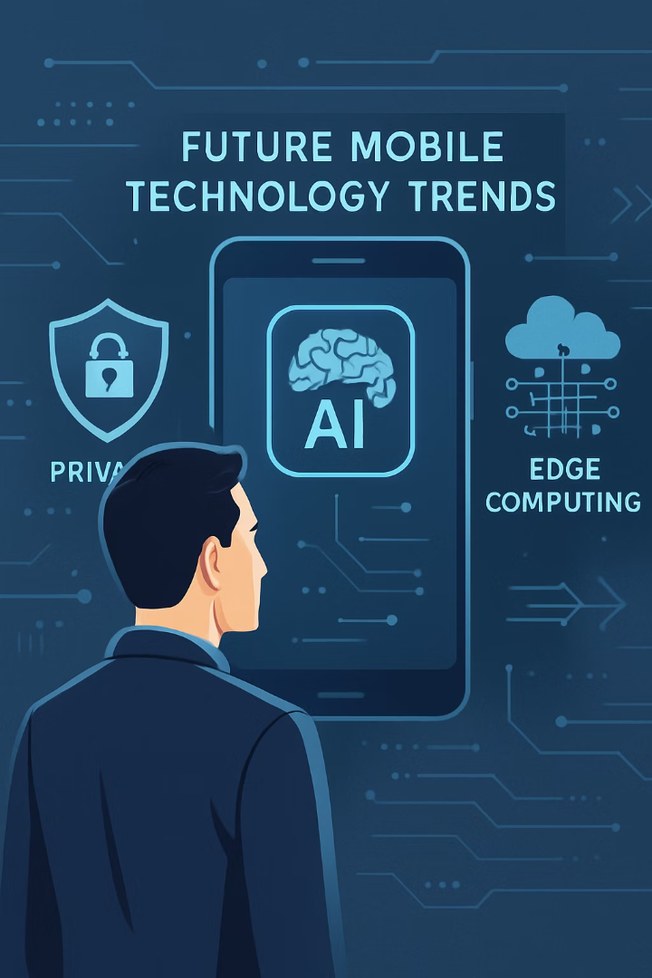
Key Takeaways and Next Steps
Design Database Architecture
Choose appropriate database solutions. Plan data structure. Implement security measures.
Implement Notification Strategy
Set up technical infrastructure. Define trigger events. Create personalization system.
Stay Current with Trends
Monitor privacy changes. Explore AI-powered notifications. Investigate edge computing options.

